Slide 1
Advanced Uses of Salesforce’s Login Flows
John M. Daniel
FinancialForce.com
@ImJohnMDaniel

Slide 2

John M. Daniel
Product Services Team
FinancialForce.com
Certified Platform Builder II
Certified Advanced Developer
Certified Admin
Certified Service Cloud Consultant
@ImJohnMDaniel

Slide 3
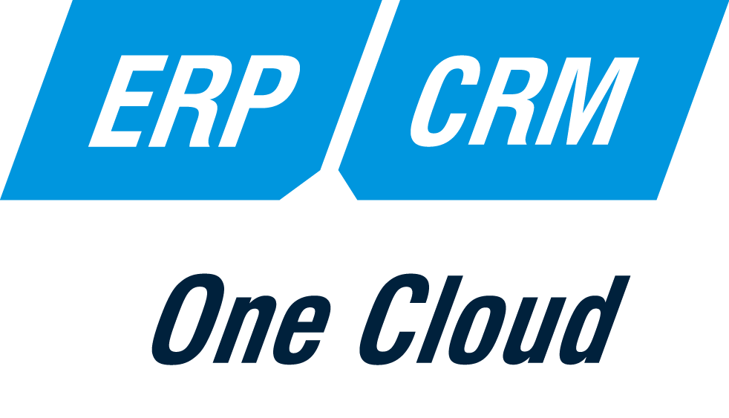
About
GREAT ALONE. BETTER TOGETHER.
Native to Salesforce App Cloud since 2009
Investors include Salesforce Ventures
Customers in 27 countries
650+ employees, San Francisco based
Dreamforce.FinancialForce.com
Notes:
First, a few quick words about FinancialForce.com.
FinancialForce.com builds ERP apps that are native to the Salesforce App cloud including Accounting, professional services automation, Human resources and Inventory applications. Our apps can be subscribed to separately or part of a whole ERP family.
Our company investors include Salesforce Ventures, which made their original investment in us in 2009.
We have customers all around the world in 27 countries and over 650 employees including those at our headquarters on 595 Market St. here in San Francisco.
We have quite few sessions and parties planned here this week, you can learn more about those at Dreamforce.Financialforce.com. Feel free to join us.

Slide 4
Login Flow Overview
What are Login Flows?

Slide 5
What are Login Flows?
They are Visual Flows
Make use of all basic aspects of Visual Flows
UI Elements
Logic Elements
Data Elements
Bound to a Profile
Initiated by user’s login event
…Let’s see one in action!!

Slide 6
Demo #1
First Time User
Accept Terms of Service

Slide 7
Login Flow setup
Two steps:
Define the Visual Flow
Bind the flow to profile

Slide 8
Define the Flow…

Slide 9
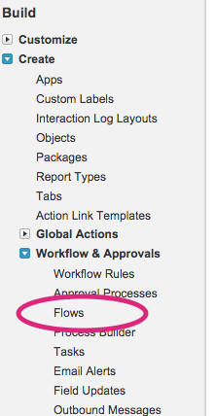
Define the Flow…
Access the Flow menu

Slide 10
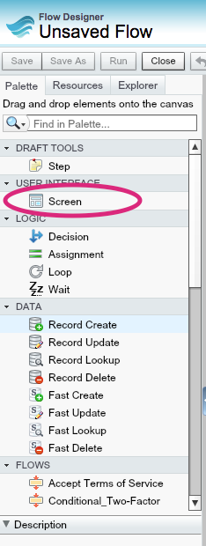
Define the Flow…
Access the Flow menu
Setup a “Screen” element
Header elements
Welcome text
Checkbox for acknowledgement
Button to move on

Slide 11
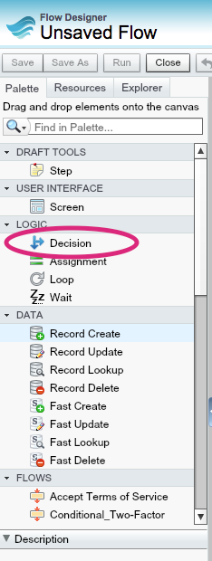
Define the Flow…
Access the Flow menu
Setup a “Screen” element
Add Logic – “Decision” element
Element Name
“Accepted” outcome
“Not Accepted” outcome

Slide 12
Bind to profile…

Slide 13
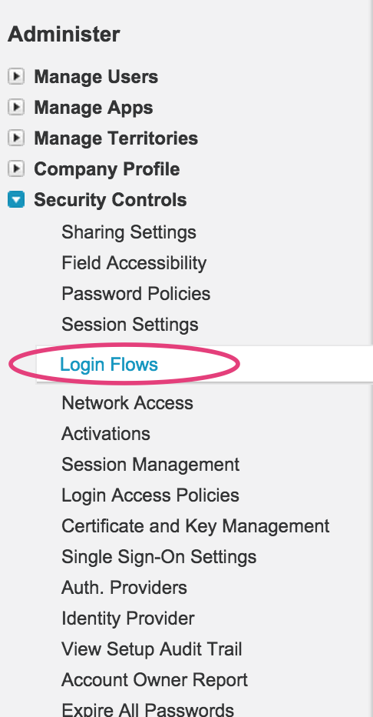
Bind to profile…
Access the Login Flows Screen

Slide 14
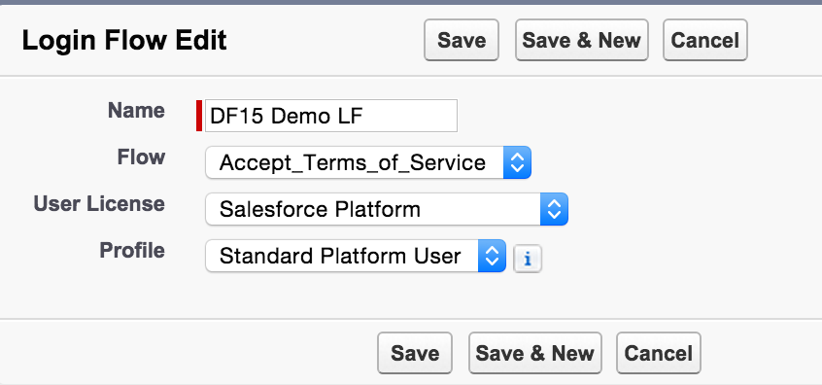
Bind to profile…
Access the Login Flows Screen
Setup the assignment to the specific profile

Slide 15
It’s that simple!

Slide 16
So… When Can You Use Login Flows?

Slide 17
Login Flow Use Cases
First time User Acceptance of Terms and Services
Gather More Information On First Time User of Communities
“Login Wizards”
Gather interests about community user to automatically subscribe to various data categories
Gather information about user’s job role
Different landing page on login …other than “Home” page
Marketing / Executive Level Sales Pipeline Dashboard when problem exists
User needs to fill in timesheet for last week – take them there first!
Address Verification

Slide 18
Demo #2
Sales Pipeline Alert Display

Slide 19
More Login Flow Use Cases
Email Based Two Factor Authentication
Automatic Registering of QR Codes / Two Factor Authentication
Require Two Factor Authentication When Outside Corporate Network
On Demand Update of Customer Community User’s Information From Backoffice
All of these use cases require Apex Code!

Slide 20
But How Do You Connect Your Flows to Apex Code?

Slide 21
Process.Plugin Apex Interface!!!
…Wait! …No! That was the old way.

Slide 22
@InvocableMethod Apex Annotation!!

Slide 23
@InvocableMethod Annotation
Allows you to expose an Apex class method to the VisualFlow configuration screen.
Use @InvocableVariable annotation to designate variables that can be passed from the Flow to your Apex class.
@InvocableMethods can be packaged!

Slide 24
Demo #3
Advanced Webservice Callout

Slide 25
Questions???

Slide 26
Links
Dreamforce ‘15 DevZone Presentations
https://github.com/developerforce/df15-devzone-presentations
Developer Tech Library – “Login Flows”
https://developer.salesforce.com/page/Login-Flows
Help Topic – “Custom Login Flows”
https://help.salesforce.com/apex/HTViewHelpDoc?id=security_login_flow.htm
“Customizing User Authentication with Login Flows” (DF14 presentation on YouTube) by Itzik Koren, Jerrod Chong, and Charles Oppenhimer
https://www.youtube.com/watch?v=gYes8OLAc-k

Slide 27
More Links
Apex Code Developer’s Guide - @InvocableMethod and @InvocableVariable
https://developer.salesforce.com/docs/atlas.en-us.apexcode.meta/apexcode/apex_classes_annotation_InvocableMethod.htm
https://developer.salesforce.com/docs/atlas.en-us.apexcode.meta/apexcode/apex_classes_annotation_InvocableVariable.htm
Force.com Actions Developer’s Guide - Apex Actions
https://developer.salesforce.com/docs/atlas.en-us.api_action.meta/api_action/actions_obj_apex.htm
Login Flow samples
https://developer.salesforce.com/page/Login-Flows#Login_Flow_samples

Slide 28
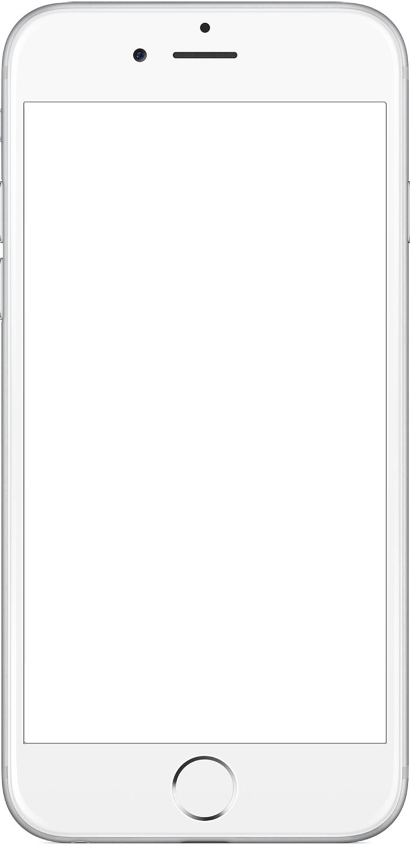


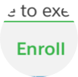
Share Your Feedback, and Win a GoPro!
Earn a GoPro prize entry for each completed survey
Tap the bell to take a survey
1
Enroll in a session
2
3

Slide 29
Thanks! Enjoy #DF15 !!!

